Slide 1
Chapter No. 05 – Internal Memory
Lecture – 10
01-05-2018

Slide 2
Topics to Cover
Semiconductor Main Memory
Organization
DRAM and SRAM
Types of ROM
Main memory is the internal memory, and each location in main memory has a unique address.
More processes can be maintained in Main Memory which increases effective use of CPU.

Slide 3
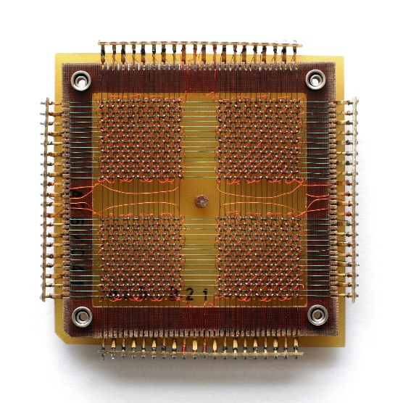
5.1 Semiconductor Main Memory
In earlier computers, the most common form of random-access storage for computer main-memory employed an array of doughnut-shaped ferromagnetic loops referred to as cores.
Hence, main-memory is often referred to as core, even to this day.
However, the advent of, and advantages of, microelectronics has long ended the days of magnetic core memory.
Today, the use of semiconductor chips for main-memory is almost universal.
Key aspects of this technology are explored in this section.

Slide 4
Main-Memory ‘Organization’
The basic element of a semiconductor memory is the memory cell.
All ‘semiconductor memory cells’ share the properties listed below:
They exhibit two stable (or semistable) states, which can be used to represent binary 1 and 0. (Semistable state = memory needs to be refreshed to keep its state).
They are capable of being written into (at least once), to ‘set the state’.
They are capable of being read (multiple times), to ‘sense the state’.

Slide 5
Transistors
For example, a memory chip contains hundreds of millions or even billions of transistors, each of which can be switched on or off individually.
Since each transistor can be in two distinct states, it can store two different numbers, zero and one. With billions of transistors, a chip can store billions of zeros and ones, and almost as many ordinary numbers and letters (or characters, as we call them).

Slide 6
Memory Cell Operation (Fig. Next)
The cell has ‘three functional terminals’ capable of carrying an electrical signal.
The select terminal 2) The control terminal 3) The Data terminal
The Select terminal: selects a memory cell for a ‘read or write operation’.
The Control terminal: indicates ‘read or write’.
For writing: the other terminal provides an electrical signal that ‘sets the state’ of the cell to 1 or 0.
For reading: that terminal is used for ‘output of the cell’s state’.

Slide 7
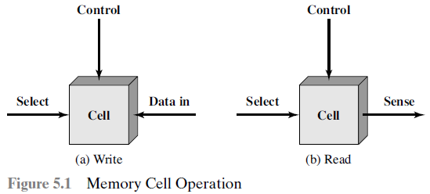
Figure 5.1 Memory Cell Operation
(Operation)
(Operation)
(Address)
(Data input)
(Address)
(Data output)
Note: Memory is addressable at ‘byte/word’ level, NOT ‘bit/cell’ level.

Slide 8
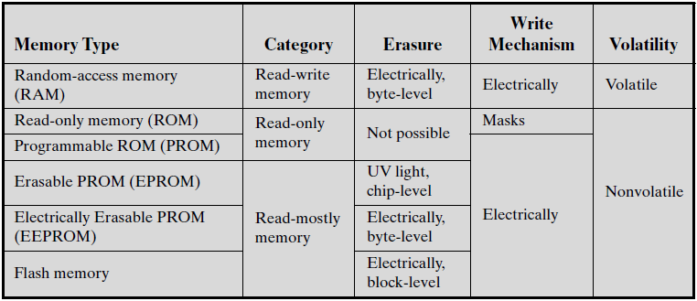
Table 5.1 Semiconductor Memory Types (R-A)

Slide 9
Characteristics of Random-Access Memory (RAM)
The most common type of semiconductor memory is referred to as random-access memory (RAM).
The following distinguishing characteristics of RAM are listed below:
RAM is of random-access type, means that it is possible both to read data from the memory and to write new data into the memory easily and rapidly.
Both the reading and writing are accomplished through the use of electrical signals.
RAM is volatile, that is, it must be provided with a constant power, If the power is interrupted, then the data are lost.
Thus, RAM can be used only as temporary storage.
The two types of RAM used in computers are DRAM and SRAM.

Slide 10
1. Characteristics of ‘Dynamic RAM’ (DRAM)
A dynamic RAM (DRAM) is made with cells that store data as charge on capacitors. (a ‘capacitor’ is an electric device that ‘stores charge’)
The presence or absence of charge in a capacitor is interpreted as a binary 1 or 0.
Because capacitor have a natural tendency to discharge, dynamic RAMs require charge refreshing to maintain data storage. (Dis-Adv)
The term dynamic refers to this tendency of the stored charge to leak away, even with power continuously applied.
So with DRAMs, a charge refreshing circuitry is required.

Slide 11
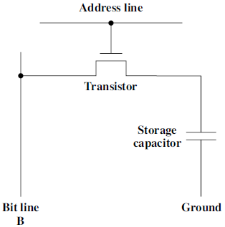
DRAM Cell
A DRAM cell is simply made up of a transistor and a storage capacitor.
The address line is activated (ON) when the bit value from this cell is to be read or written.
The transistor acts as a switch, that is closed (allowing current to flow) if a voltage is applied to the address line and open (no current flows) if no voltage is present on the address line.
(Base)
(collector)
(emitter)
DRAM cell, stores one bit
(Charged, 1
or
Discharged)
(Data line)
‘Address line’ is ON, then transistor is ON, and connects the capacitor to the ‘Bit-line’ (B).

Slide 12
DRAM Read and Write Operation
For the write operation:
A voltage signal is applied to the bit-line (B); a high voltage represents 1, and a low voltage represents 0.
A signal is then applied to the address line, allowing a charge to be transferred to the capacitor.
For the read operation:
When the address line is selected, the transistor turns on and the charge stored on the capacitor is fed out onto a bit-line.
The ‘sense amplifier’ compares the bit-line value to a reference value and determines if the cell contains a logic 1 or a logic 0.
The readout discharges the capacitor, whose value must be restored.

Slide 13
2. Characteristics of ‘Static RAM’ (SRAM)
A static RAM (SRAM) is a digital device that stores the bits as ON/OFF switches.
In a SRAM, binary values are stored using traditional flip-flop logic-gate configurations (flip-flop is a sequential circuit that stores a bit).
A static RAM will hold its data as long as power is supplied to it, no charge will leak. (Advantage)
Therefore no charge refreshing circuitry is required in an SRAM.
Note: Flip-flop is a bistable device, that exists in one of the two states, and in the absence of input, remains in that state, so a 1-bit memory.
Flip-flop has two complemented outputs, generally labelled Q and Q.

Slide 14
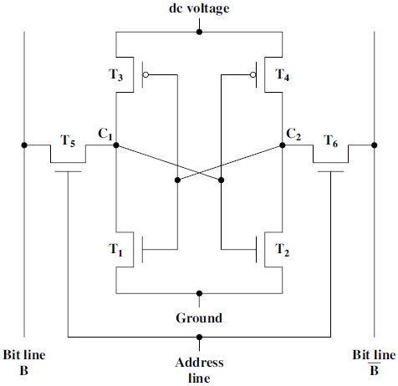
SRAM Cell
Skip
(Both states are stable as long as the ‘dc voltage’ is applied)
Transistors (T₁, T₂, T₃, T₄) arrangement gives two stable logic states.
Logic State 1
C₁ high, C₂ low
T₁ T₄ off, T₂ T₃ on
Logic State 0
C₂ high, C₁ low
T₂ T₃ off, T₁ T₄ on
‘Address line’ controls transistors T₅ and T₆ which act as ‘switch’.
T₅ & T₆ allow read or write operation.
Logic State 1
ON =
= OFF
= High
Low =
(Switch)
(Switch)
OFF =
= ON
SRAM Advantage: No refresh is needed to retain data.

Slide 15
SRAM Read and Write Operation
For the write operation, the desired bit value is applied to line B, while its compliment is applied to line B. Address line is then selected.
This forces the four transistors (T₁, T₂, T₃, T₄) into the proper state. (1)
For a read operation, the bit value is read from line B. Provide Adress.

Slide 16
SRAM versus DRAM
Dynamic RAM (DRAM) | Static RAM (SRAM)
A DRAM is a volatile-memory. | An SRAM is a volatile-memory.
Memory cell is simpler to build and smaller. | Memory cell is more complex in construction.
Smaller DRAM cell means more cells per unit area and dense memory. (more Kbs stored / unit area) | A SRAM cell has larger per bit area, so memory capacity is small. (less Kbs stored / unit area)
DRAM requires the supporting ‘refresh circuitry’ due to charge leak. | SRAM does not require the ‘refresh circuitry’, no charge leaks away.
DRAM memory is less expensive per bit cost. | SRAM memory is more expensive per bit.
DRAM is used for large memory requirements, e.g. main memory (RAM), and is slower to access. | SRAM memory is faster to access and thus is used as ‘Cache memory’.
DRAM is an ‘analog memory’, a ‘capacitor’ can store any charge value, a threshold determines stored 1 or 0. | SRAM is a ‘digital device’, that uses flip-flops as ‘switch’ to store binary 1 or 0.

Slide 17
Characteristics of Read-Only Memory (ROM)
A read-only memory (ROM) contains a permanent pattern of data that can not be changed.
A ROM is non-volatile; that is, no power source is required to maintain the bit values in memory.
While it is possible to only read a ROM, it is not possible to write new data into it.
Other potential applications of ROM include: library subroutines (for frequently wanted functions), system programs (BIOS), and function tables, all of them reside in ROM.
The advantage of ROM is that the data or program is permanently in main-memory and need never be loaded from a secondary storage device.

Slide 18
Programmable ROM (PROM)
In a ROM, the data is actually wired into the chip as part of the fabrication process (written during manufacture, fabricating/masking)
The programmable ROM (PROM) is non-volatile and is written into / programmable only once.
Special equipment is required for the writing or “programming” process. (called photolithography)

Slide 19
Types of ROM
Read-mostly memory, which is useful for applications in which read operations are far more frequent than write operations but for which non-volatile storage is required.
There are three common forms of read-mostly memory:
EPROM 2) EEPROM 3) Flash memory.
Erasable programmable read-only memory (EPROM): is erased by UV. But all the storage cells must be erased to the same initial state.
Electrically erasable programmable read-only memory (EEPROM): take much longer to write than read, can be written without erasing prior contents.
Flash memory: provides flexibility to erase whole memory in blocks.

Slide 20
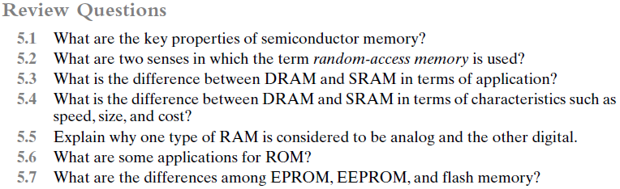
Preparatory Questions
(Chapter 5)
(Slide-04)
(Slide-09)
(Slide-10 & 13)
(Slide-16)
(Slide-16, Point-7)
(Slide-17)
(Slide-19)

